Slide 1
Smart Resume Analyzer(ATS)
Presented By
Guided By
Dr. Abhishek Prabhakar
SATYAM GUPTA
TEJ PRATAP SINGH
Kapil Kumar Pandey
Notes:
These can be changed to reflect your school’s specific rules.

Slide 2
INTRODUCTION
There is a growing tendency by background screening companies to make use of IT in
employment screening. According to the National Association of Professional Background
Screeners (NAPBS, 2005), ‘‘increasingly technology has become an integral part of the
screening industry... Many companies are demanding that screening companies work
within their clients’ environments’'.
This technique stated parsing of the resumes with least limit and the parser works the utilization of two
or three rules which train the call and address.Scout bundles use the CV parser system for the determination of resume. This framework will determine and shape future background screening procedures that take into account the use of the web and internet technologies to streamline recruitment and background screening approaches. Besides there is a growing concern by human resources professionals to find ways to implement an effective pre-employment screening
program that is also cost-effective

Slide 3
OVERVIEW
Nixon (2008) a Background Screening Expert believes that the true challenge that
companies face as they embark on this background journey is to balance the need for
standard practices with the increased use of IT in screening.The balancing gap needs an effective employment background screening framework that will be used to
improve the effectiveness of IT in background screening industry.
The use of the web and internet technologies to streamline recruitment and
background screening approaches.

Slide 4
Methodology
The development of a framework is theory generation which uses both the descriptive qualitative and quantitative approaches. The study used mainly the inductive approach based
on the theoretical findings that IT enabled employment screening systems have more than
one use context (i.e. recruitment, selection, screening and hiring) The development of a framework is theory generation which uses both the descriptive
qualitative and quantitative approaches. The study used mainly the inductive approach based
on the theoretical findings that IT enabled employment screening systems have more than
one use context (i.e. recruitment, selection, screening and hiring) After sending the responses were successfully collected and analysed.

Slide 5
The Framework
1st stage: gathering of evidence
The 1st stage was concept and categories formulation from technical data encoded from
the technical literature derived from websites of background screening firms, internet articles
from professional background screeners, most of which came from the NAPBS and recruitment
and employment agencies. The process of comparing information from various documents
resulted in the discovery of a number of concepts and categories classified as recruitment,
selection, screening and hiring.It will simplify the hiring process.

Slide 6
2nd stage: Data collection
The 2nd stage resulted in the discovery of the IT tools used to carry out the processes in each concept category above. Analysis of information obtained from internet articles on the subjects of recruitment and employment (R & E), pre-process in the initial framework could be summarised in four steps starting with: (i) IT based recruitment (i.e. online job applications) through (ii) selection (pre-employment screening
checks for matching of personal information with job requirements) to (iii) background
screening for verifying personal information and storing information into Database (iv) hiring of candidates for jobs.

Slide 7
3rd stage: Data analysis
This framework consists of a sequence of activities in information management (IM) knowledge areas involved together with the
processes occurring in background screening.
The information processing tools are integrated together in a logical
and systematic manner. which would generate completed background screening reports (CBSR) to enable the hiring process to be decided and use eOffers.

Slide 8
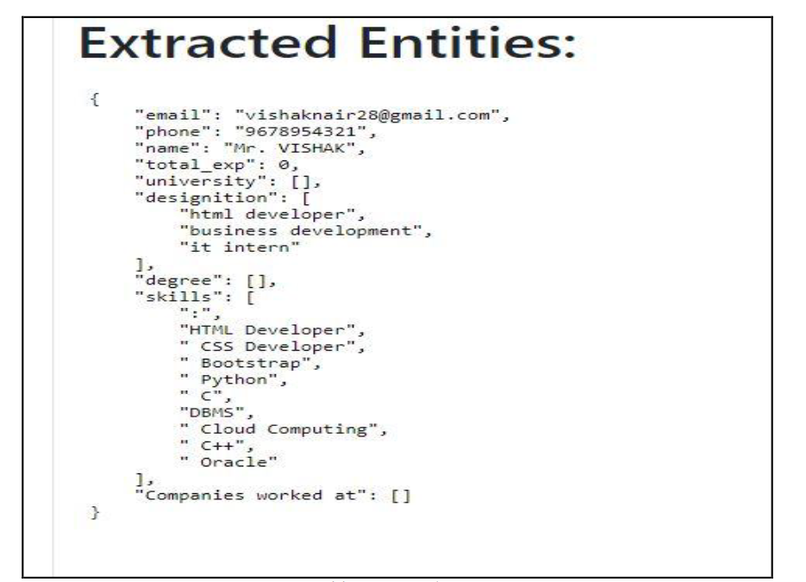
Extracted Entity Table

Slide 9
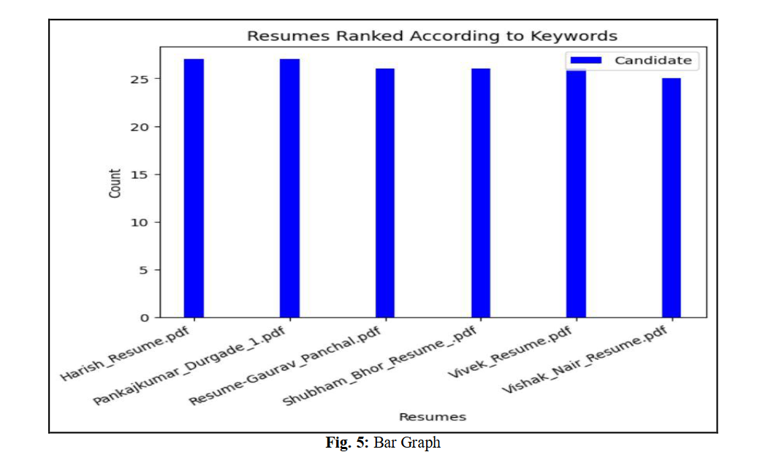
Table-3

Slide 10
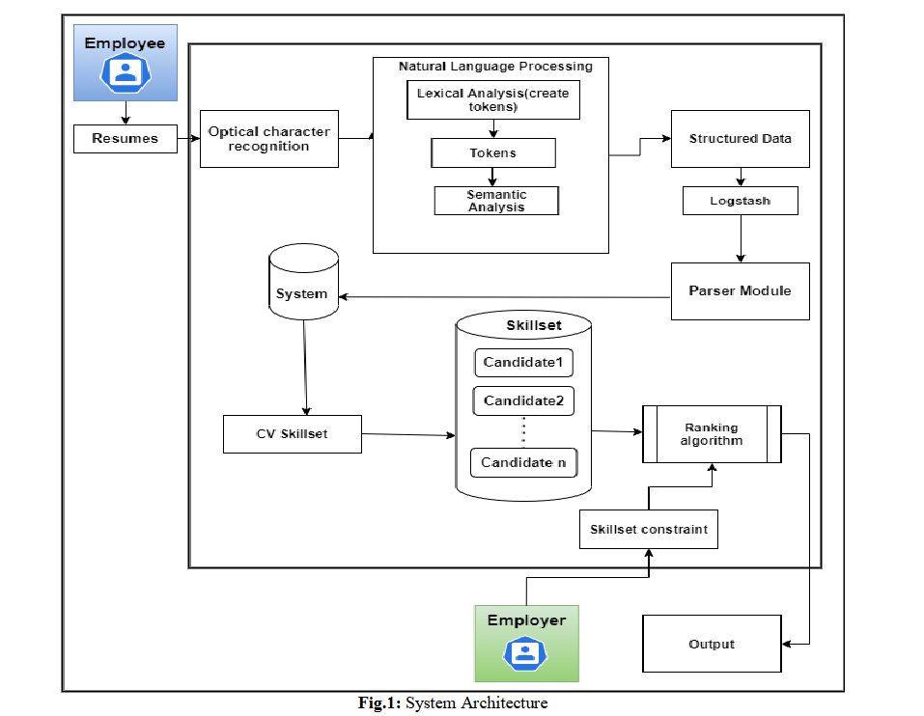
SYSTEM ARCHITECTURE

Slide 11
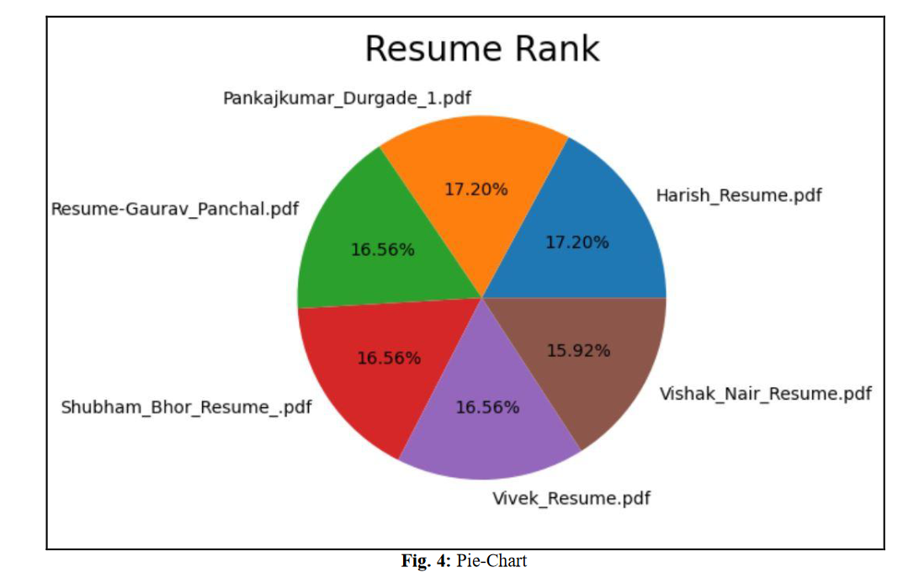
Pie Chart

Slide 12
Reference
Vinaya R. Kudatarkar, ManjulaRamannavar, Dr.Nandini S. Sidnal “An Unstructured Text Analytics Approach for Qualitative
Evaluation of Resumes”, 2015, IJIRAE.
Satyaki Sanyal, Neelanjan Ghosh, SouvikHazra, Soumyashree Adhikary, “Resume Parser with Natural language Processing”,
2007,IJESC.
Papiya Das, Manjusha Pandey, Siddharth Swarup Rautaray, “A CV parser Model using Entity Extraction Process and Big Data
Tools ”, 2018,IJITCS.
Ayishathahira and Sreejith,, “Combination of Neural Networks and Conditional Random Fields for Efficient Resume
Parsing”,International CET Conference on Control, Communication and Computing(IC4),2018..
Notes:
*Change this verbiage to the language your school uses.

Slide 13
CONCLUSION AND FUTURE ENHANCEMENT
Our approach is to make the work of companies and candidates easier and effective. Basically our aim
is to ease the recruitment process. The process will provide the quality of applicants for the companies. The
unfair and discriminatory practice in the process will be dampened. Based on the information in the form of
technical skills the resumes will be ranked in order.
Our project has accuracy up to 80 percent.

